Slide 1
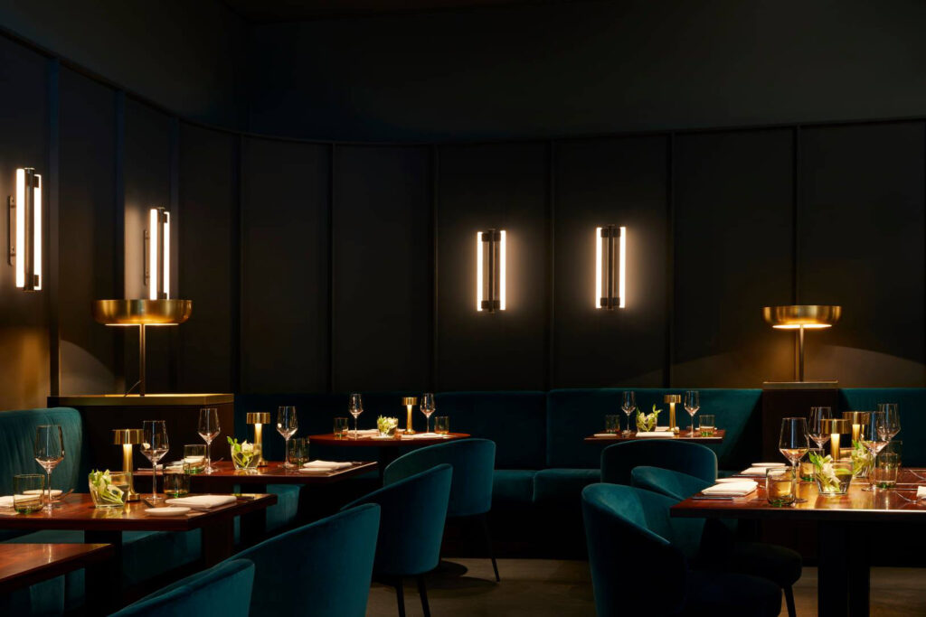
ABOUT US
THE BAWARCHIS’, the multi-award winning & critically acclaimed flagship of Passion F&B, Amritsar is the birthplace of ‘innovative Indian cuisine’, offering guests a progressive Indian fine-dining experience. THE BAWARCHIS’ was introduced to diners in 2019 and since has been considered among the leading restaurants, paving the path towards fostering the legacy of Indian food and flag bearer of contemporary Indian food, showcasing the robustness of Indian cuisine and the hidden gems, yet unexplored.
Complementing the elevation of space design, the dynamic, young team of chefs under the able guidance of the group’s award-winning, Corporate Chefs, have skillfully crafted a new culinary experience that engages all the senses. Inspired by, and credited with reviving, the unique concept of gueridon service, the menu at THE BAWARCHIS’ showcases traditional dishes from the sub-continent presented with a modernistic approach. Embracing various regional Indian culinary influences that have woven its way into the cuisine, THE BAWARCHIS’ menu is sophisticated, imaginative, highly visual and engaging, lending each dining experience as a unique culinary journey. THE BAWARCHIS’ is present in Amritsar, Ludhiana & Jalandhar, India.
THE BAWARCHIS’

